Slide 1
Watching Jesus Grow Up
Luke – Chapter Two

Slide 2
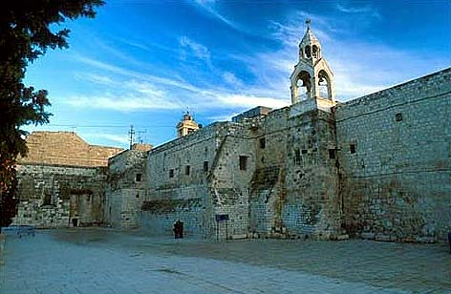
Notes:
Church of the Nativity in Bethlehem, Israel. Small entrance door in center. Built by Constantine’s mother, Helena. Thought to be on original site of stable.

Slide 3
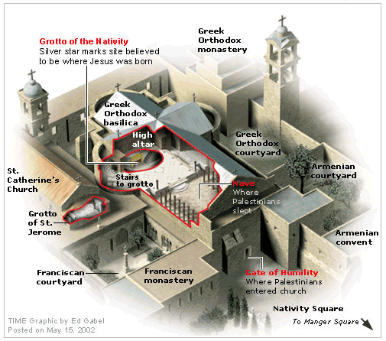
Notes:
Diagram of floor plan of Church of the Nativity, Bethlehem.

Slide 4
Entrance to basement room of church
Church of the Nativity, Bethlehem, Israel
Notes:
Apartment below church where Jerome spent 30 years translating the Bible from Hebrew & Greek into Latin.

Slide 5
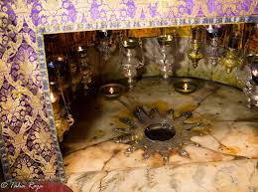
Notes:
Thought to be exact site of birthplace of Christ.

Slide 6
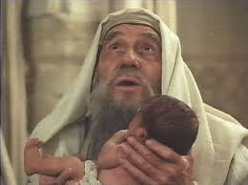
Notes:
Actor portraying old Simeon in the temple, blessing Jesus.

Slide 7
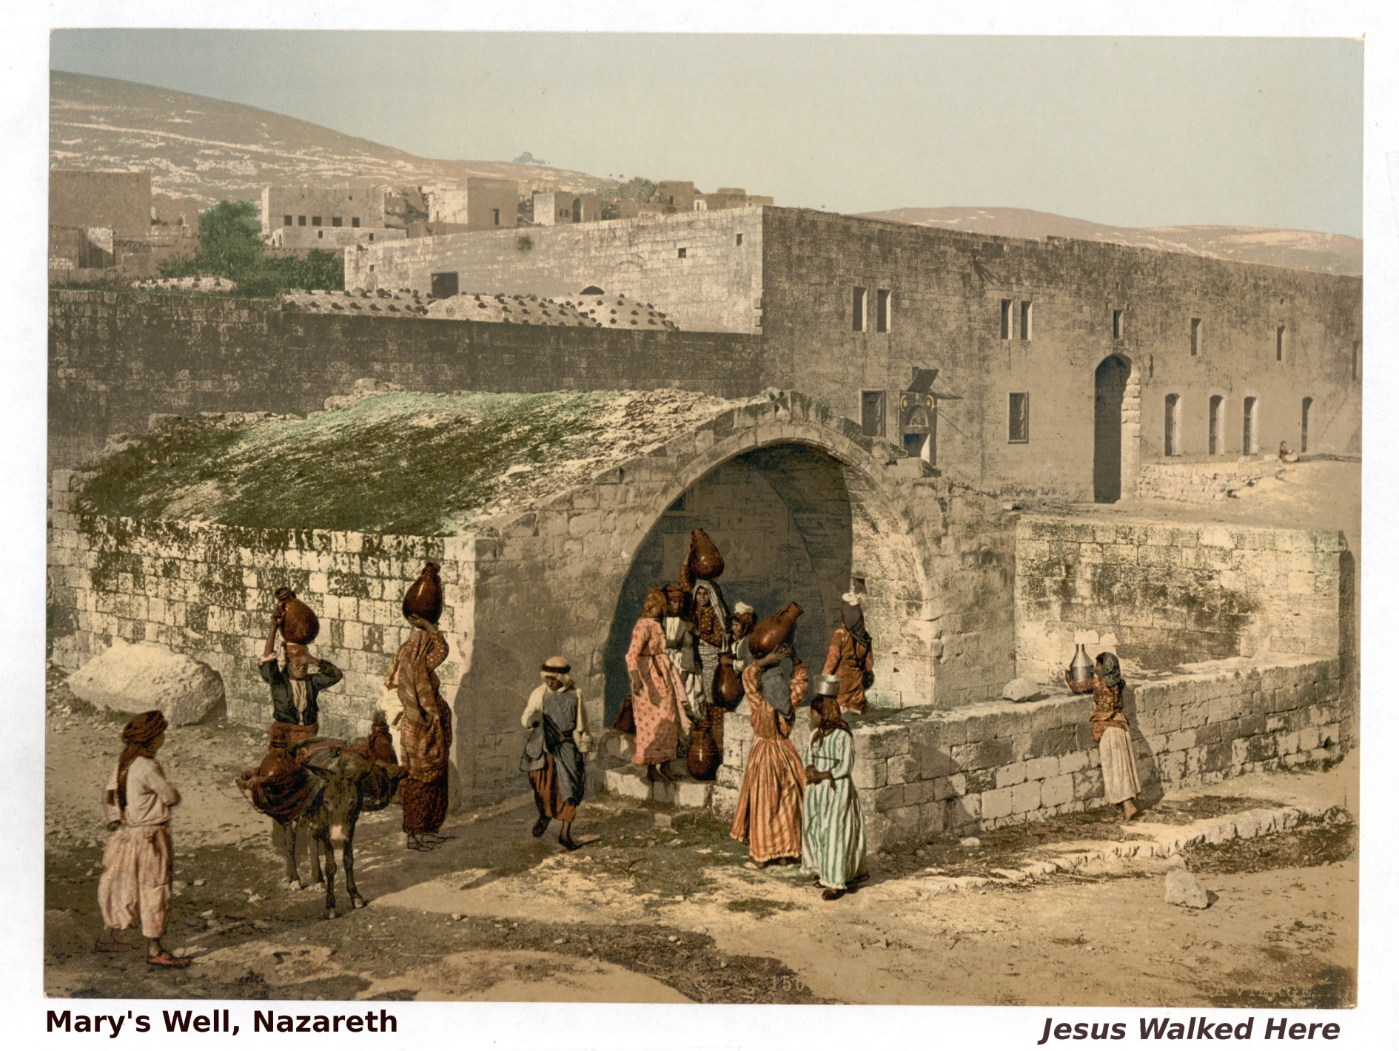
Notes:
Water came here to this well in Nazareth from an uphill stream about a mile away, via conduit.

Slide 8
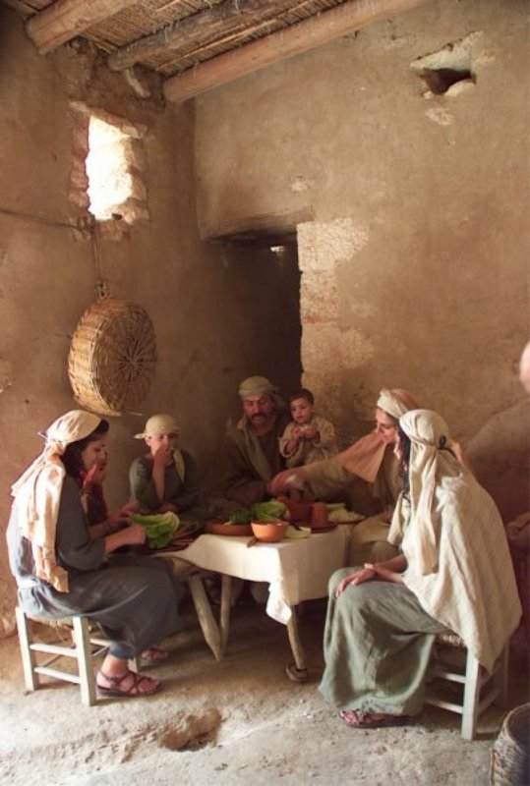
Notes:
Typical poor family in Bible days. There were at least 7 children in Mary & Joseph’s family.

Slide 9
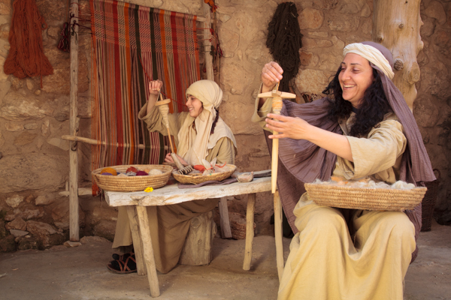
Notes:
Perhaps Mary taught her daughters to spin and weave.

Slide 10
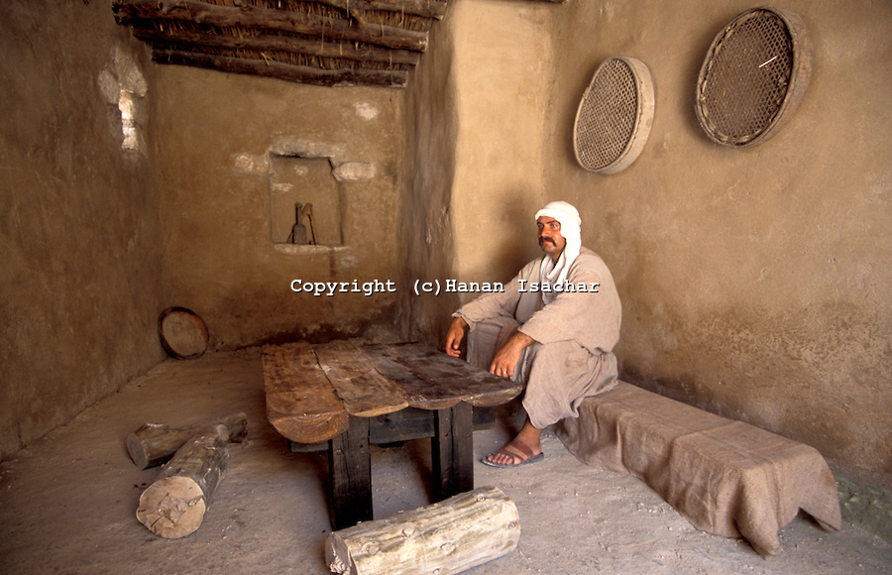
Notes:
Poor family’s home.

Slide 11
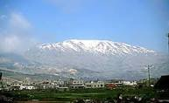
Notes:
Mt. Hermon, tallest peak over 9,000 ft. above sea level. On border of Israel, Lebanon, & Syria. Can be seen 60 miles away. Jesus could see this from Nazareth. Today Israel owns part of mt., since 1967 war, and has a ski resort on a peak about 7,000 ft. tall.

Slide 12
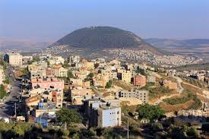
Notes:
Nazareth today.

Slide 13
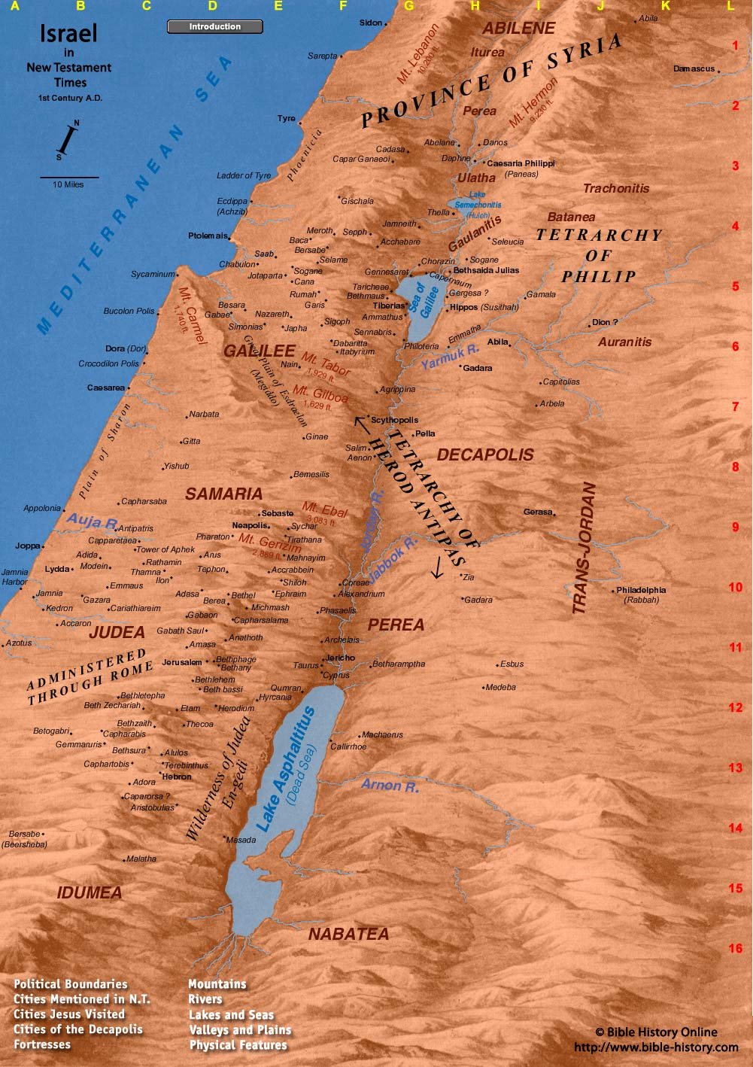
Notes:
http://www.bible-history.com/geography/ancient-israel/mount-hermon.html. See regions on map.

Slide 14
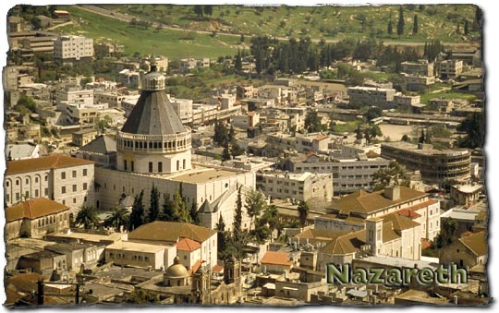
Notes:
Modern Day Nazareth.

Slide 15
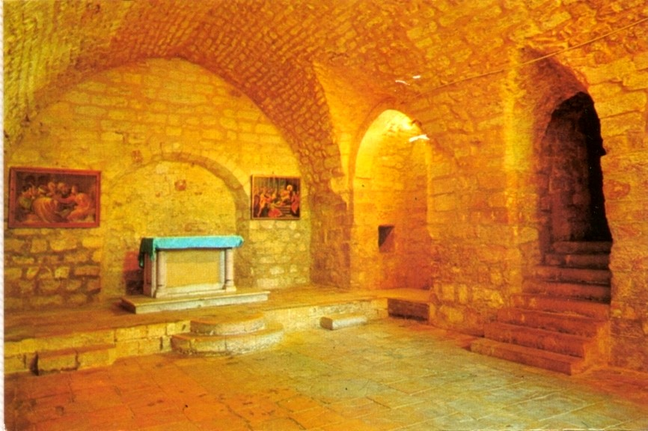
Notes:
Church built over site of synagogue in Nazareth.

Slide 16
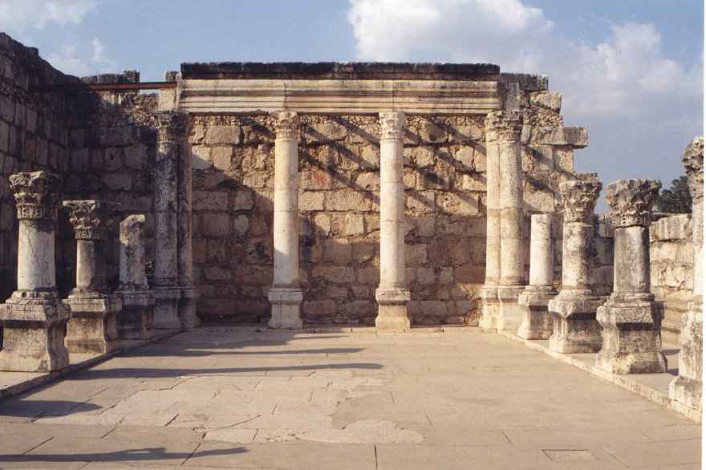
Notes:
Synagogue of Capernaum. This one dated AD 200-300. Restored by Franciscans. Probably built over site of synagogue of Jesus’ day.

Slide 17
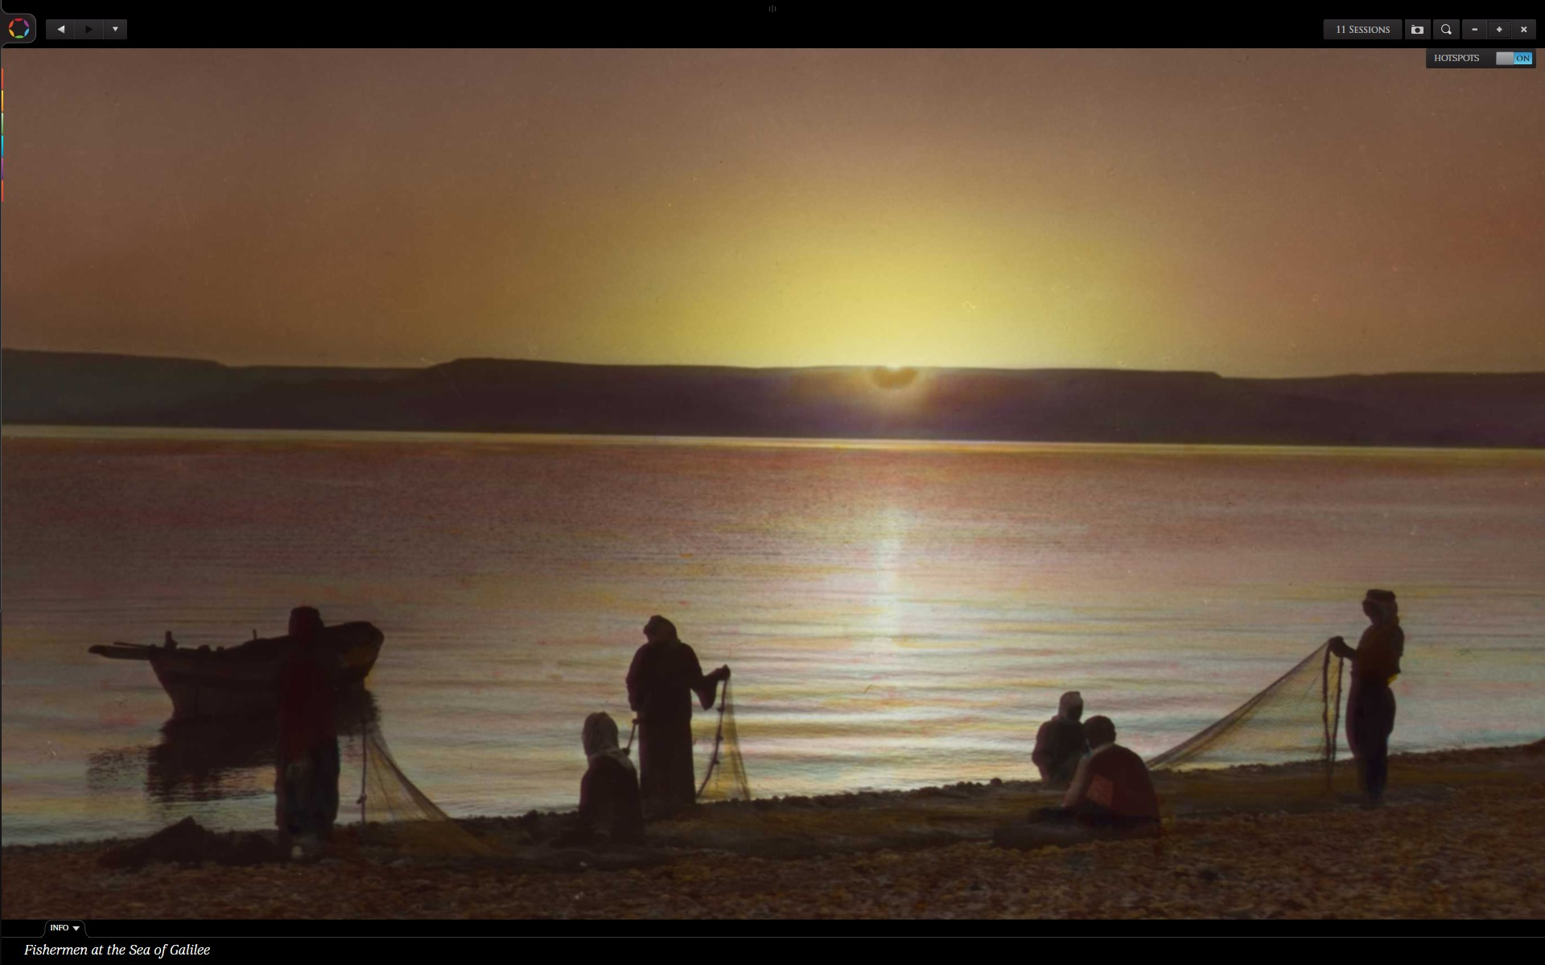
Notes:
Fishermen at the Sea of Galilee (sunrise or sunset??)

Slide 18
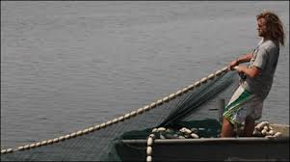
Notes:
Fisherman pulling in his net.

Slide 19
“Lord” Greek kurios
As divine title of Jesus, occurs in NT 663 times. That the intent is to identify Jesus Christ with the OT Deity is evident from Mat. 3:3; 12:8; 21:9; (Ps. 118:26) 22:43-45; Lk. 1:43…John 20:28…. Scoffield Bible p. 1005
OT – LORD=Jehovah, Lord = Adon or Adonai
“Kurios” is Greek equivalent of Adonai.
Notes:
Jesus first called “Lord” (Kurios) in Luke 5 or Matt. 8 – by Peter and leper.

Slide 20
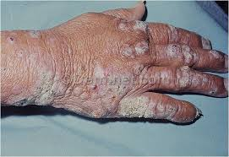
Notes:
Leprous hand from Google search “images of lepers.”

Slide 21
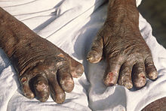
Notes:
Leprous hands - from Google search “images of lepers.”

Slide 22
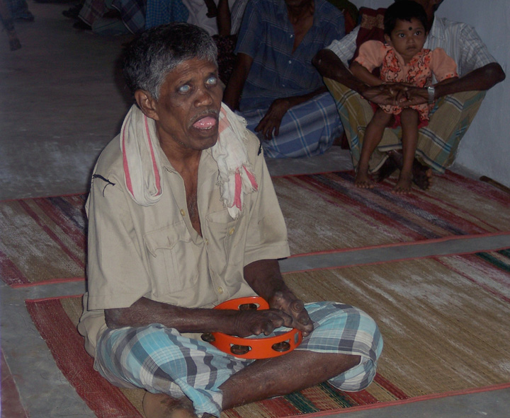
Notes:
from Google search “images of lepers.”

Slide 23
Lord,
if you are willing, you can make me clean.
Notes:
Words of leper, Luke 5 & Matt. 8.

Slide 24
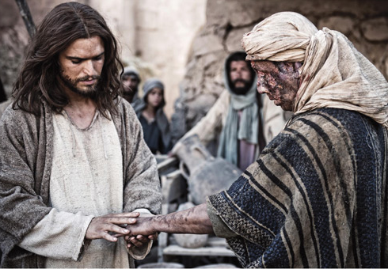
Notes:
from Google search “images of lepers.”

Slide 25
I am willing.
Be clean.
Notes:
Words of Jesus to leper.

Slide 26
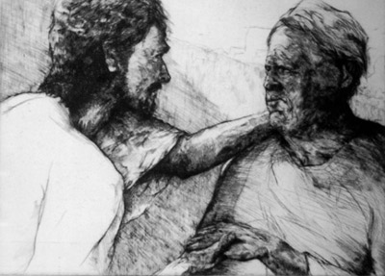
Notes:
from Google search “images of lepers.” Jesus with leper. Moved with compassion (Mark 1:41)

Slide 27
Jesus Becomes Famous & Controversial
Luke 5:15 – 6:16 Dealing with fame & conflict
5:15 -Jesus retreats for prayer.
5:17-26 - Jesus heals a paralytic.
5:27-32 – Jesus calls Levi (Matthew).
5:33-39 – Jesus is questioned about fasting, explains his new agenda.
6:1-11 – Jesus is Lord of Sabbath. 2 events
6:12-16 – Jesus calls 12 disciples (apostles).

Slide 28
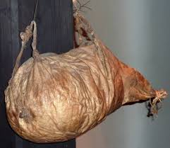
Notes:
Wineskin made from animal.

Slide 29
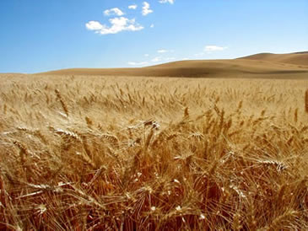
Notes:
Barley field. Harvest is usually late March, early April.

Slide 30
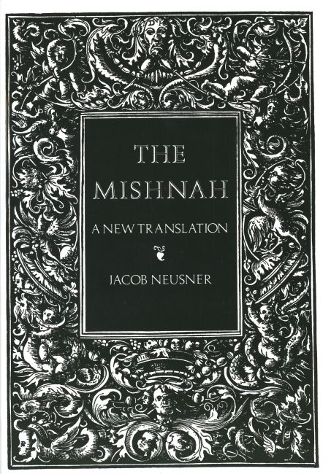
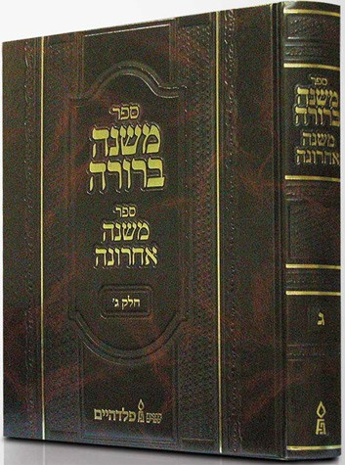
Notes:
Hebrew reference book, The Mishnah, list many, many rules for keeping the Torah, law of Moses.

Slide 31
Jesus heals man with withered hand.
https://www.youtube.com/watch?v=uNUjdRPt3Do
Notes:
YouTube video (about 2 min.) on synagogue scene of Jesus healing man with withered hand.

Slide 32
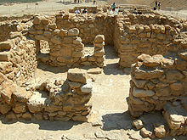
Notes:
Essenes’ town Qumran near Dead Sea. http://en.wikipedia.org/wiki/Essenes Group believed to have left the Dead See Scrolls.

Slide 33
Talmud
Oral Law to explain written law.
Notes:
The Oral Law is a legal commentary on the Torah, explaining how its commandments are to be carried out. Common sense suggests that some sort of oral tradition was always needed to accompany the Written Law, because the Torah alone, even with its 613 commandments, is an insufficient guide to Jewish life. For example, the fourth of the Ten Commandments, ordains, "Remember the Sabbath day to make it holy" (Exodus 20:8). From the Sabbath's inclusion in the Ten Commandments, it is clear that the Torah regards it as an important holiday. Yet when one looks for the specific biblical laws regulating how to observe the day, one finds only injunctions against lighting a fire, going away from one's dwelling, cutting down a tree, plowing and harvesting. Would merely refraining from these few activities fulfill the biblical command to make the Sabbath holy? Indeed, the Sabbath rituals that are most commonly associated with holiness-lighting of candles, reciting the kiddush, and the reading of the weekly Torah portion are found not in the Torah, but in the Oral Law. http://www.jewishvirtuallibrary.org/jsource/Judaism/talmud_&_mishna.html

